Slide 1
Analysis of London Boroughs for new business opportunity
March 2020

Slide 2
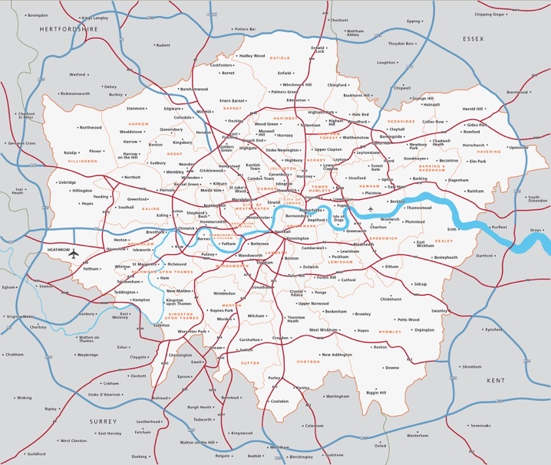
London Boroughs
32 Boroughs
600 Square Miles
Where is the best place to launch a new coffee shop?

Slide 3
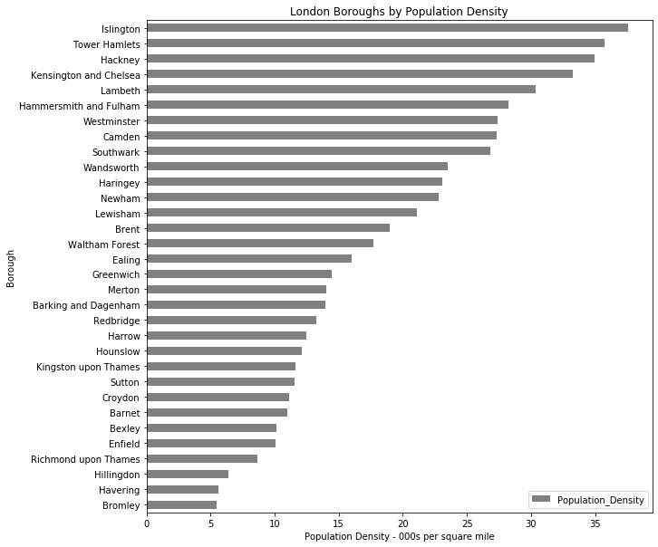
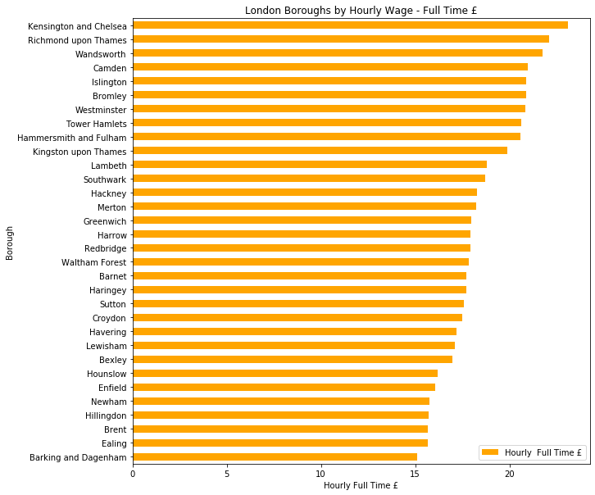
Boroughs vary dramatically by Population Density and Hourly Wage

Slide 4
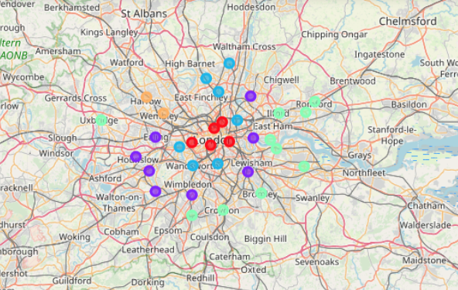
Clustering shows commonality of Boroughs
Red = Most Common Venue as Hotels
Purple = Most Common Venue as Pub
Green = Most Common Venue as Pubs/Parks
Blue = 2nd Common Venue as Coffee Shops
Amber = Most Common Venue as Indian Restaurants

Slide 5
Conclusions
Recommend Islington for new Coffee Shop
Second smallest Borough it benefits from 215k people in 5.7 square miles
5th highest wage at £20.9 per hour in 2019
Coffee shops and pubs are only the 3rd and 4th most common venue

